Slide 1

Property, Plant & Equipment Part 3 – Video

Slide 2
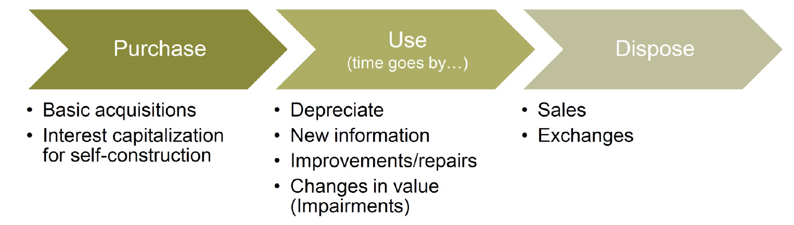
PP&E Life Cycle

Slide 3
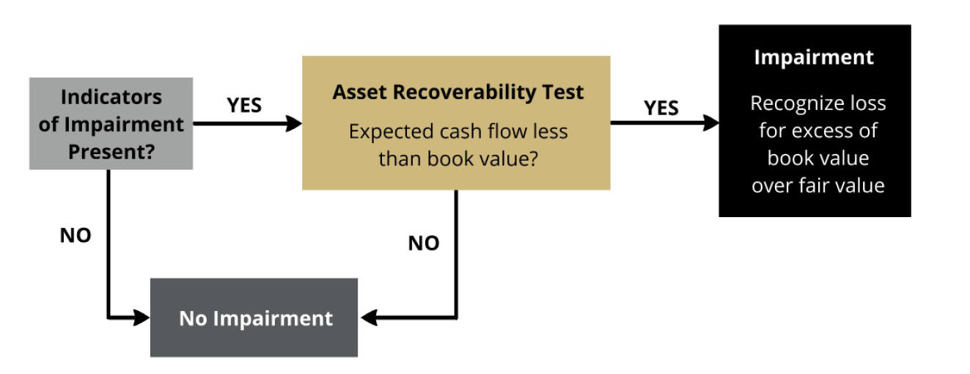
Changes in Market Value of Assets
Asset impairment occurs when future economic value of the asset (ability to generate future cash flow) decreases significantly
Notes:
Accounting is conservative:
-Don’t write up (i.e., don’t realize any holding gains until sell the asset)
-Write down (i.e., incur holding costs immediately)
Implication:
-may have some buildings/land with much greater MV than recorded.
-can’t recog gain unless sell.
-leads to some shady transactions where form=sale, substance=retained
-e.g., sale-leaseback (FASB plugged this hole: no longer a sale w/gain recog)
Undiscounted cash flows:
-includes maintenance
-assumptions about future use (e.g., “highest and best use”, firm assumptions, market assumptions

Slide 4
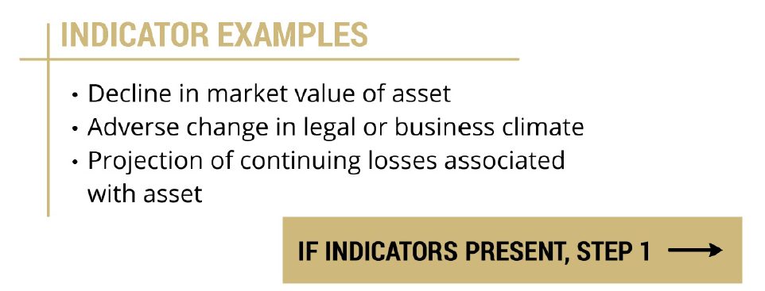
Indicators of Impairment
Test for impairment when there are triggering events or change in circumstances that indicator possible impairment.

Slide 5
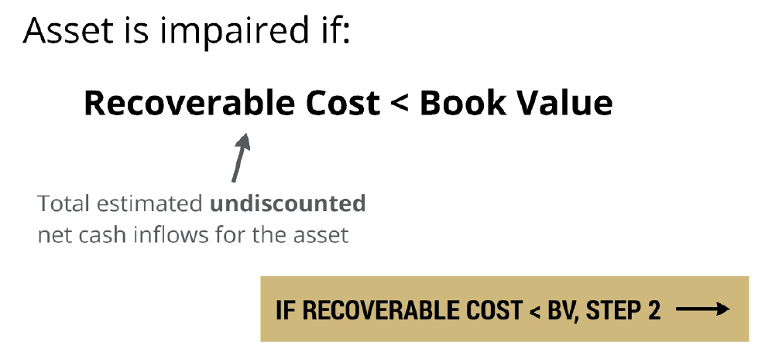
Step 1: Asset Recoverability Test

Slide 6
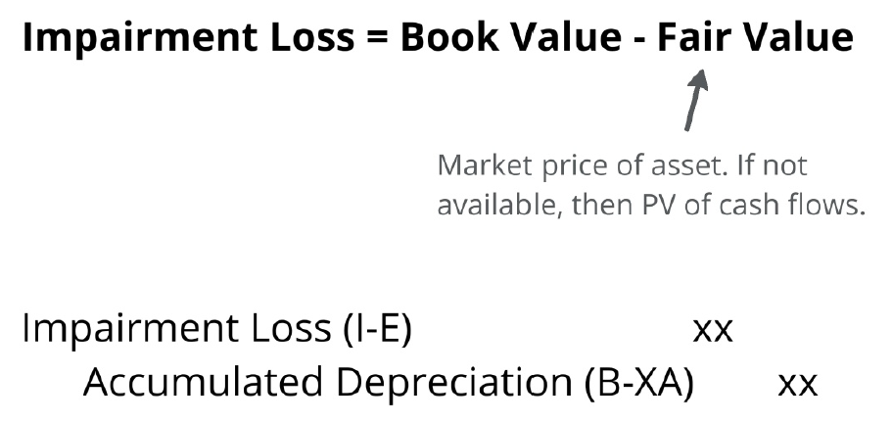
Step 2: Impairment

Slide 7
Impairment Example #1
Surprise Inc. owns a specialized oven to make pizza. Facts:
At 12/31/2013, cost basis is $18,000 and acc depr is $4,000
Net Book Value = 18,000 – 4,000 = $14,000
The “best” estimate of expected cash flows over the next four years (undiscounted) related to the oven are:
2014: $2,000
2015: $2,500
2016: $3,000
2017: $3,500
Total $11,000
The fair value of the oven at December 31, 2013 is $9,000.
Notes:
Step 2: Lots of estimates, this is just the “best” one
Step 3: Not FV of cash flows from step 2 b/c
i. firm est of cash flows is not necessarily the same est market would make
ii. Don’t know market discount rate

Slide 8
Impairment Example #1
When: Assume “events and changes in circumstances” indicate possible impairment
Recoverability test:
$11,000 (Est. cash flow) < $14,000 (Net Book Value)
→ Need impairment
Write down to fair value (~ market price)
Notes on fair value:
Value the “market” would place on the asset given how market participants (not the firm) would use it.
Write-down from NBV ($14,000) to FV ($9,000)
Loss (I-E) $5,000
Accumulated Depr (B-XA) $5,000
Notes:
Remember:
− est. cash flows of $11,000 is based on firm assumptions and use.
− est. market value based on market assumptions and use

Slide 9
PP&E Life Cycle

Slide 10
Assets Retirements
When a long-term tangible asset is disposed, the financial statements need to reflect this event
Remove asset (original cost and accumulated depreciation)
Record consideration received (if any)
Record a gain or loss if consideration received ≠ book value
Gain if proceeds > Book Value
Loss if proceeds < Book Value

Slide 11
Assets Retirements
Standard sale: Regular Co. sells a machine that cost $100,000 and has $20,000 of accumulated depreciation for $110,000 in cash.
Cash (B-A) 110,000 (consideration received)
Accumulated Depreciation (B-XA) 20,000 (remove in full)
Gain (I-R) 30,000
Asset (B-A) 100,000 (remove in full)
NBV = 80,000
Cash = 110,000
Gain = 30,000

Slide 12
Assets Retirements
Standard sale: Regular Co. sells a machine that cost $100,000 and has $20,000 of accumulated depreciation for $110,000 in cash.
Cash (B-A) 110,000 (consideration received)
Accumulated Depreciation (B-XA) 20,000 (remove in full)
Gain (I-R) 30,000
Asset (B-A) 100,000 (remove in full)
NBV = 80,000
Cash = 110,000
Gain = 30,000
Warning: You might need to record depreciation expense before the sale (if it is not up to date).

Slide 13
Closing Thoughts
Asset impairments lead to write downs of the book value to fair value
PP&E can be written down for impairment, but can never be written up.
In sale of PP&E, remember to check whether accumulated depreciation is current as of the disposal date.

Slide 14
Property, Plant & Equipment Part 3 – Video

